Slide 1

Web pages for United Youth Orchestra
Yoshiki Tatsumi

Slide 2
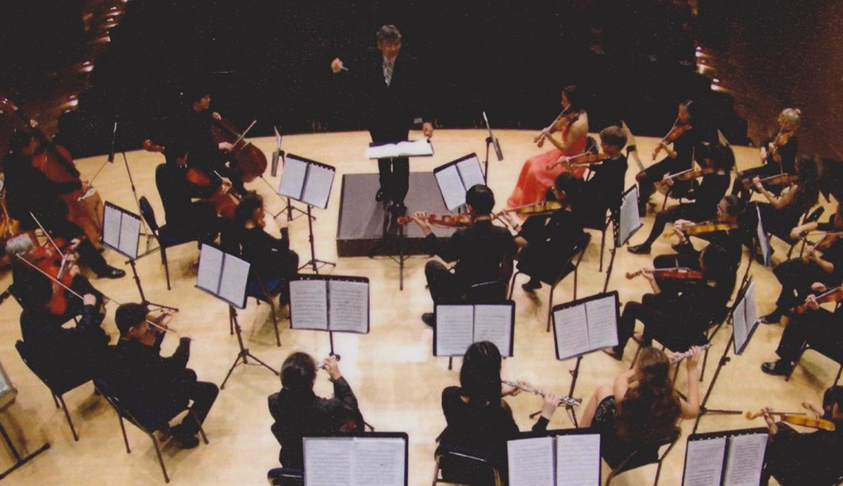
Introduction
United Youth Orchestra
- a community
orchestra for
young people
Purpose
Goals
Features
Notes:
Requirement
To advertise upcoming concerts.
To get more audience for the concerts with donations.
To inform activities.
To notify information to current members and to attract more members.
To appeal past activities.
To succeed the grant application and to attract more members.
Features
Video or audio by one of UYO’s own performance.
Featuring facebook logo to jump facebook page.
Have members only corner for informing notice and member list.
Image gallery to appeal past activities.
Have emailing feature on the Web page (pending).

Slide 3
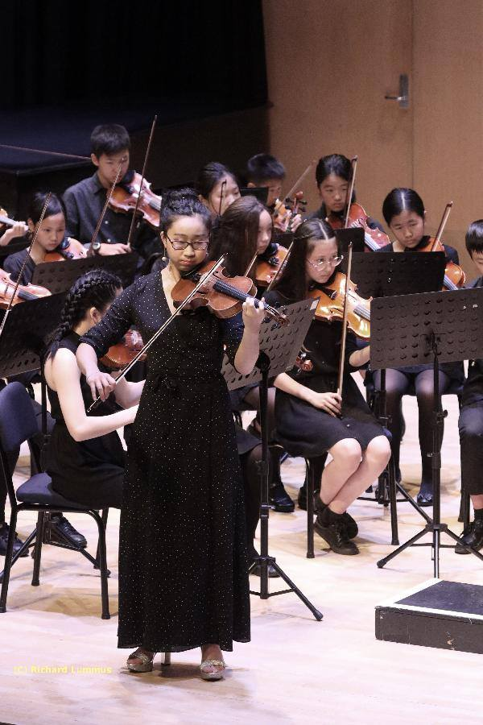
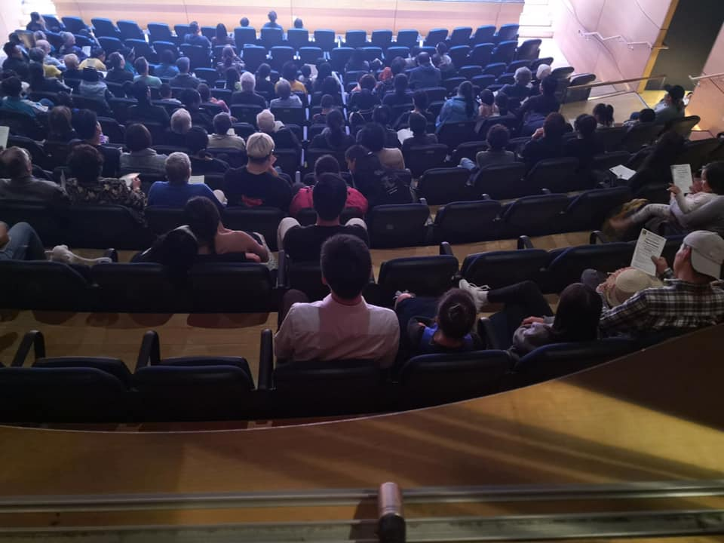
Planning
Audience
General public Young students
Notes:
Audience
General public who loves classical/orchestral music to attend the concerts.
Mainly secondary school students, their parents/guardians, and music teachers for getting prospect members.
General public and grant provider who oversees young people’s activity for providing grant / sponsoring / donation.

Slide 4
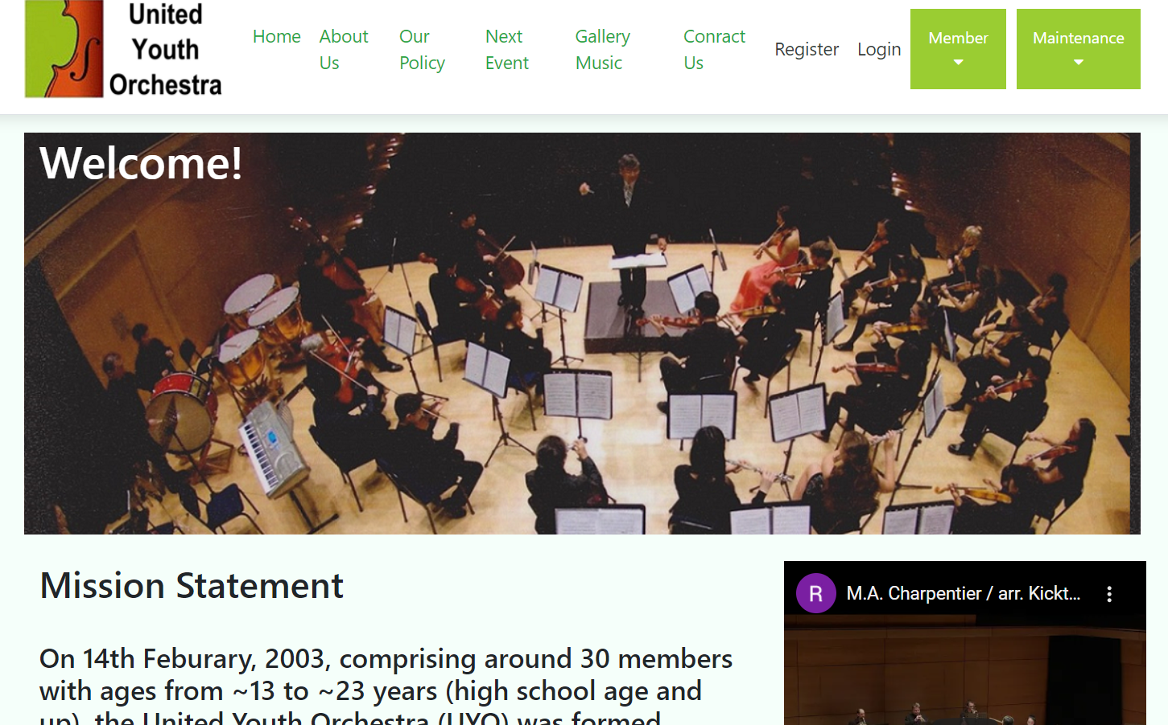
Home page
This is United Youth Orchestra’s home page, which the first page that visitors will see, being their first impression of the group. There is a brief description of what the group provides and offer to the members and visitors.
Notes:
Home page
This is United Youth Orchestra’s home page, which the first page that visitors will see, being their first impression of the group. There is a brief description of what the group provides and offer to the members and visitors.

Slide 5
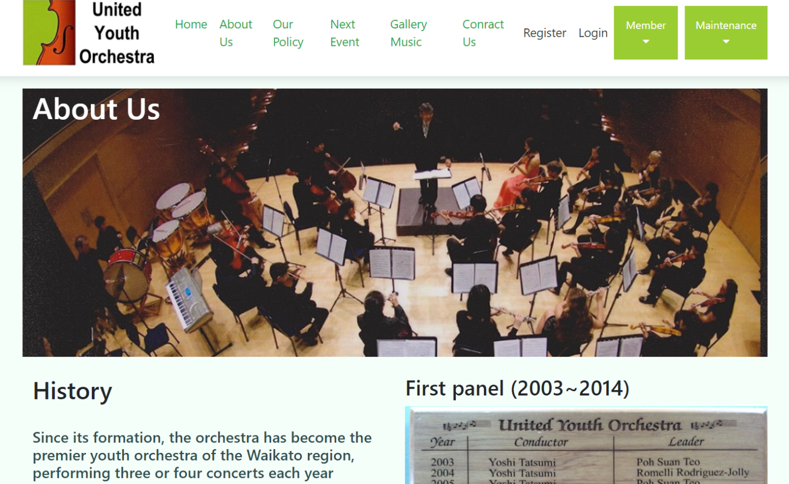
About Us
On the About Us page, it provides the group’s history and activity.
Notes:
About Us
On the About Us page, it provides the group’s history and activity.

Slide 6
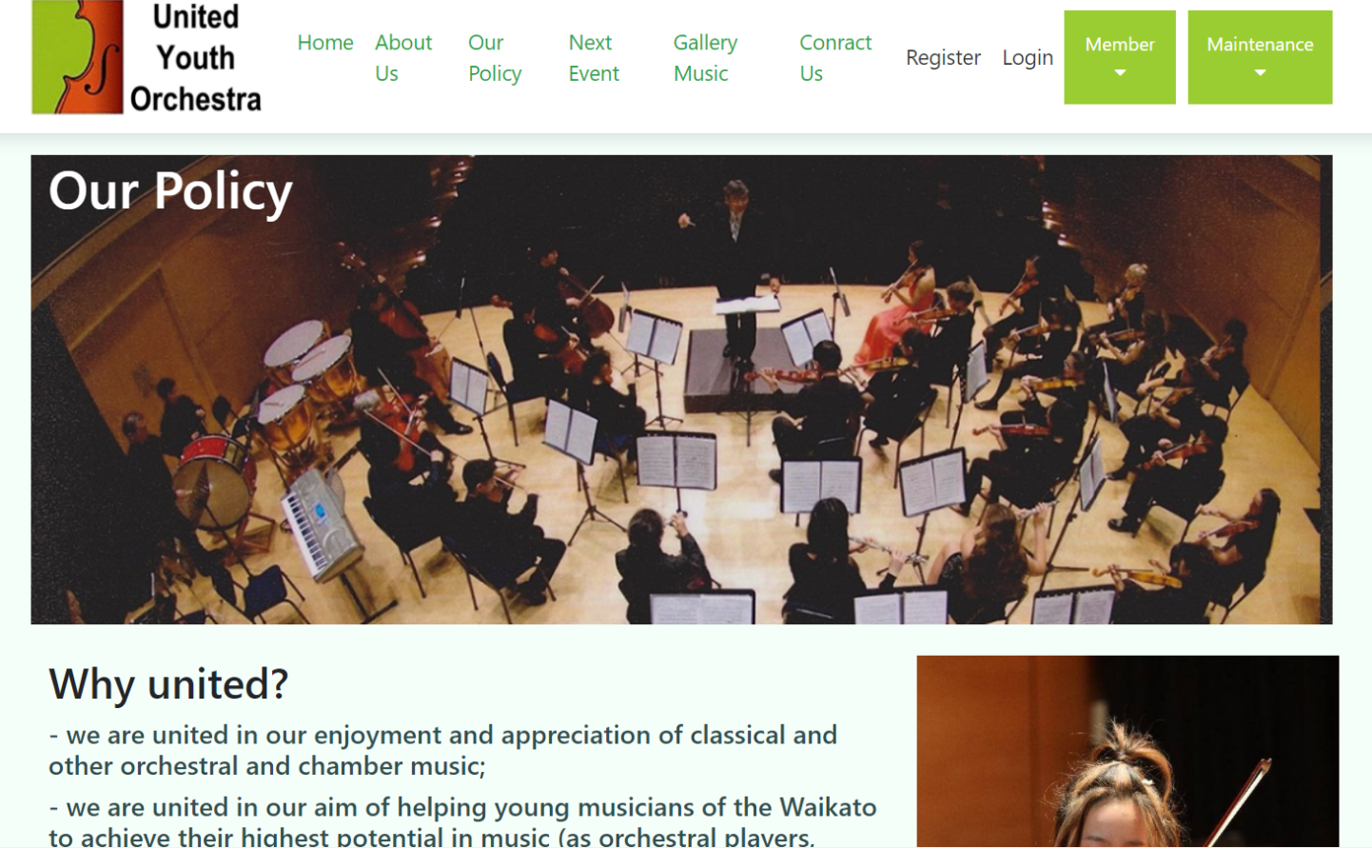
Our Policy
On the Our Policy page, it provides UYO’s Policy.
Notes:
About Us
On the About Us page, it provides the group’s history and activity.

Slide 7
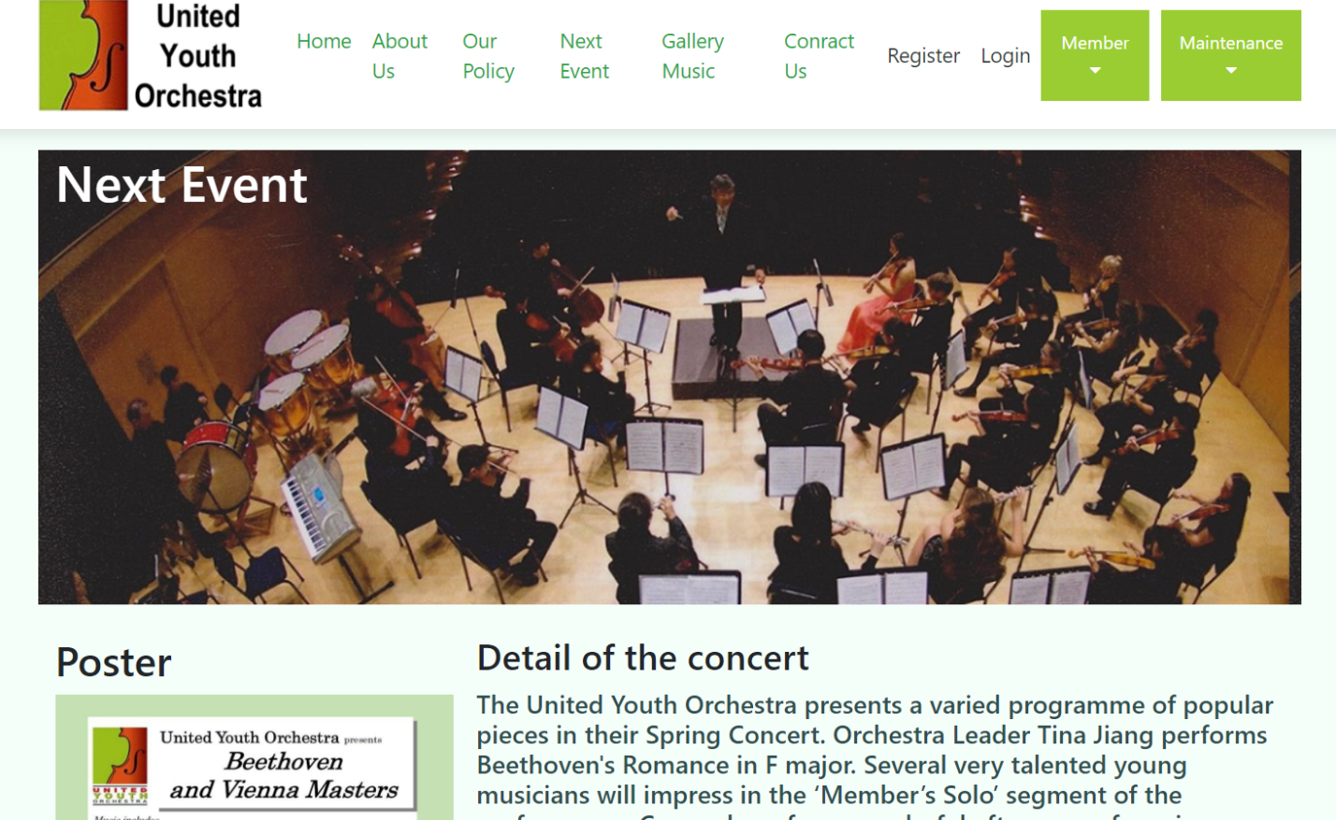
Next Event
On the Next Event page, it provides information of next event in general.
Notes:
Next Event
On the Next Event page, it provides information of next event in general.

Slide 8
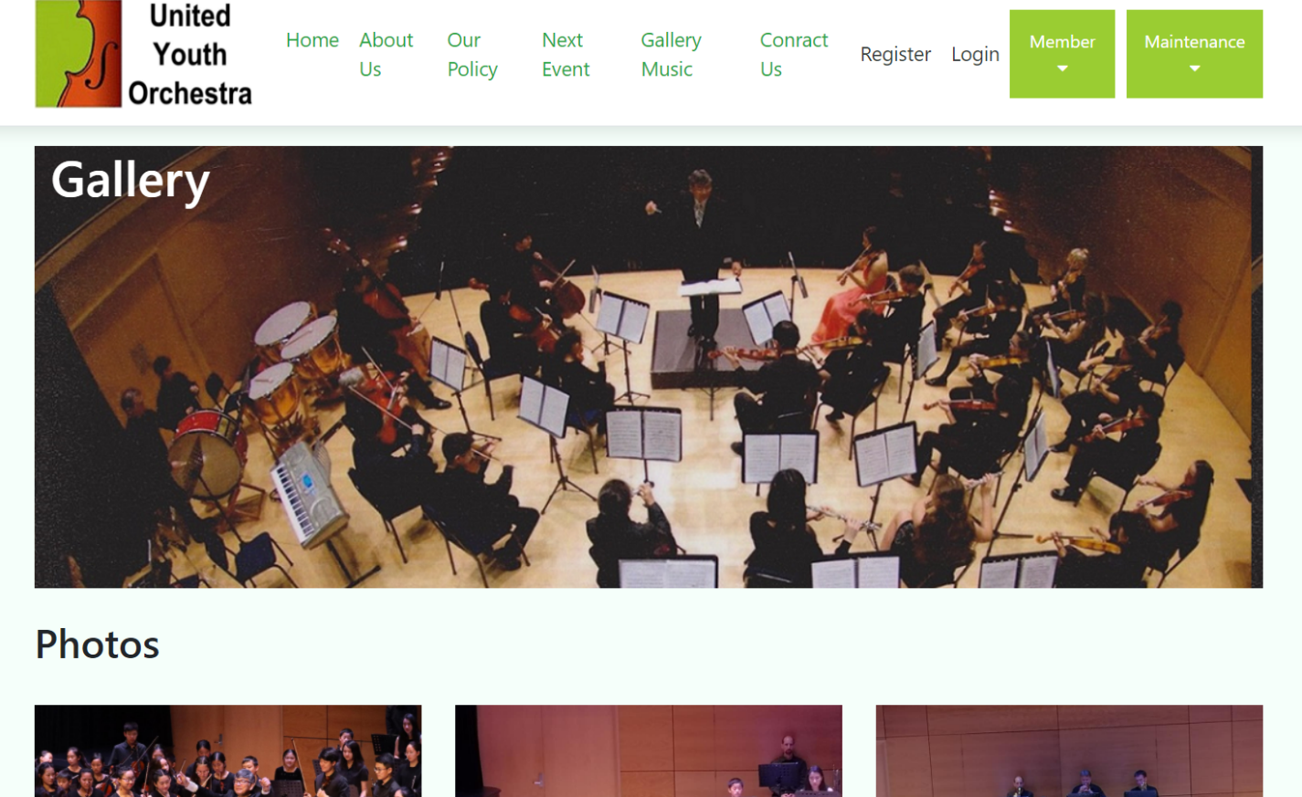
Gallery / Music
On the Gallery / Music page, it provides information of past activities.
Notes:
Gallery / Music
On the Gallery / Music page, it provides information of past activities.

Slide 9
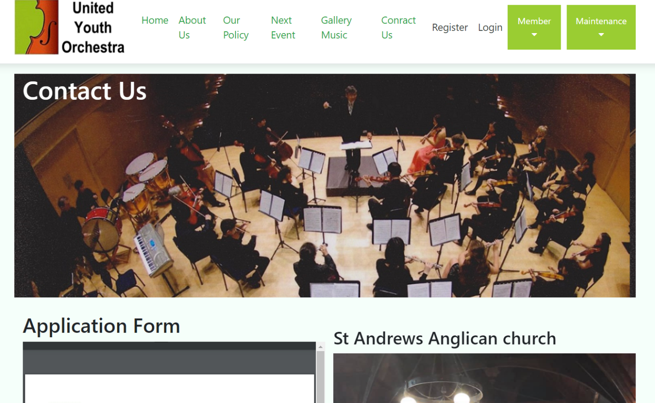
Contact Us
On the Contact Us page, it provides information of how to apply and contact us.
Notes:
Contact Us
On the Contact Us page, it provides information of how to apply and contact us.

Slide 10
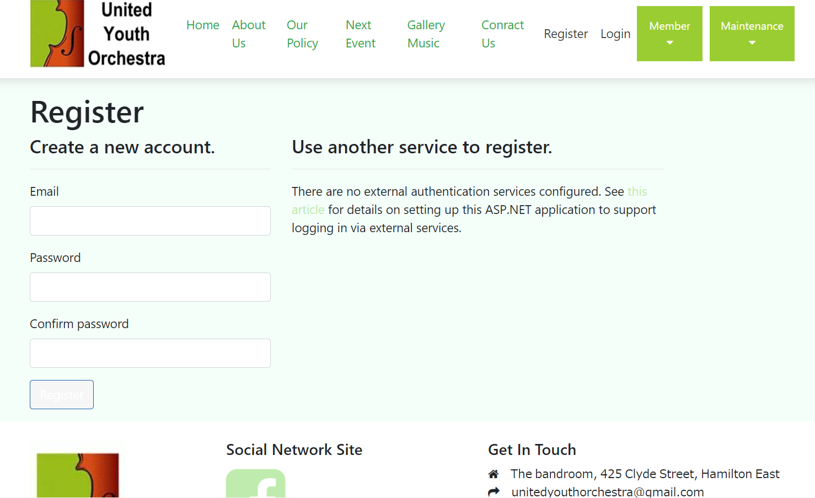
Register
On the Register page, members are welcome to register.
Notes:
Register
On the Register page, members are welcome to register and get more information.

Slide 11
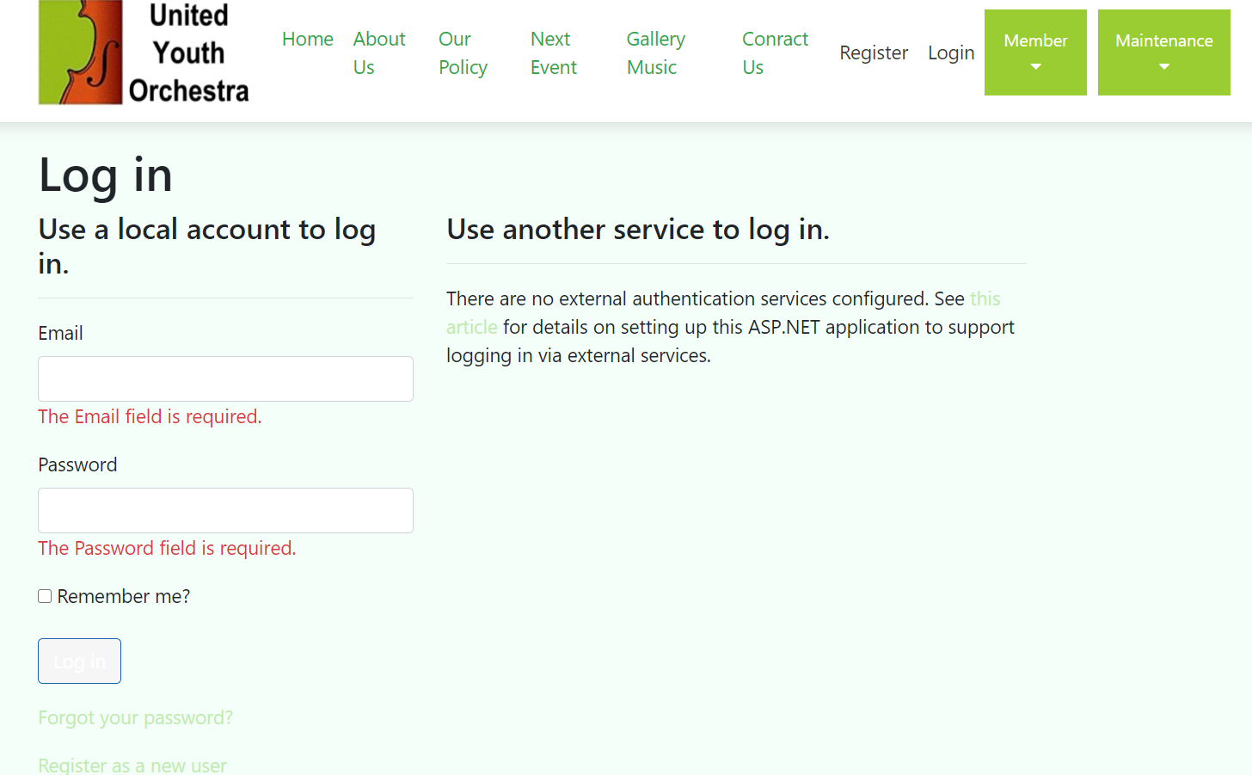
Login
On the Login page, members are welcome to login and get more information.
Notes:
Login
On the Login page, members are welcome to login and get more information

Slide 12
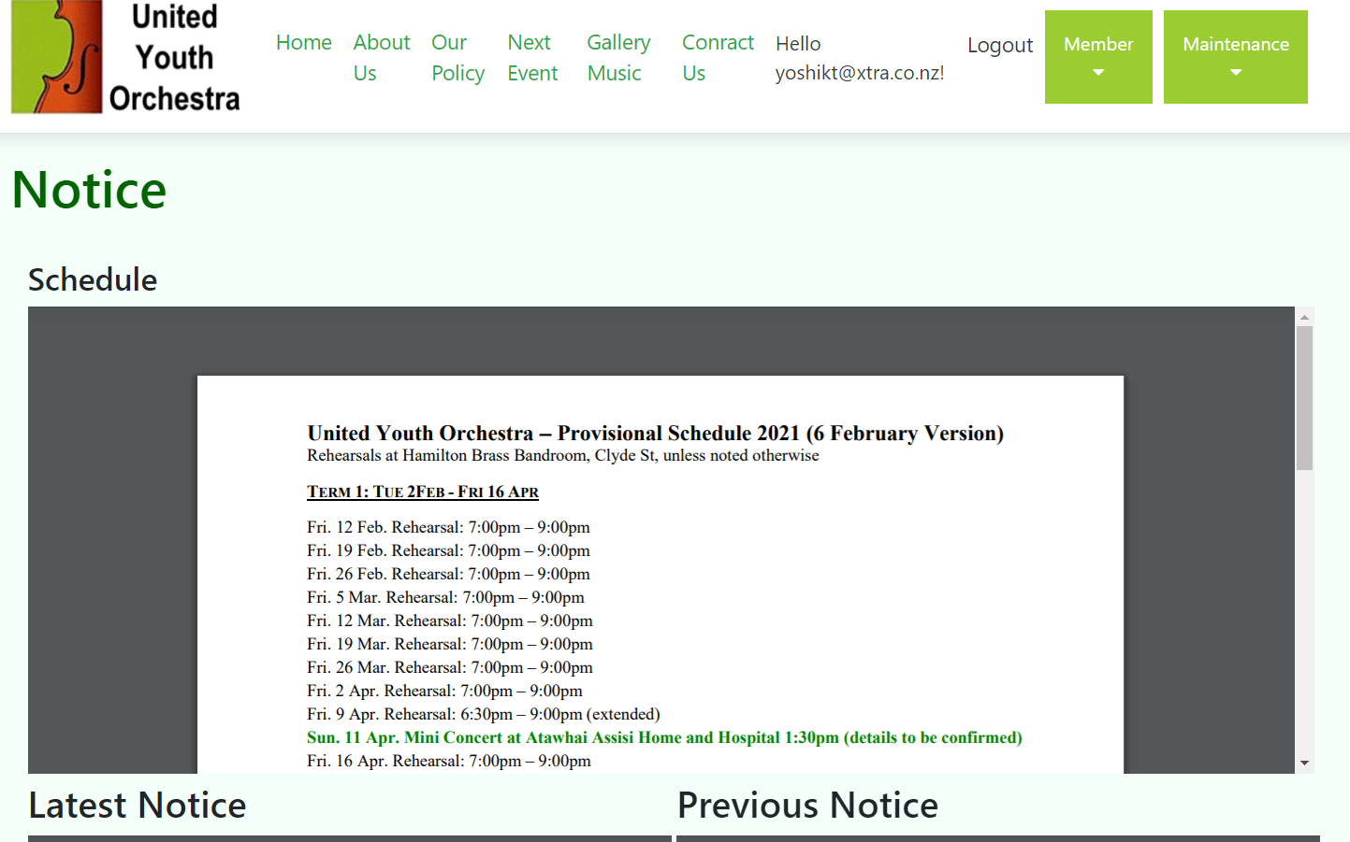
Notice
On the Notice page, members get more information.
Notes:
Notice
On the Notice page, members get more information.

Slide 13
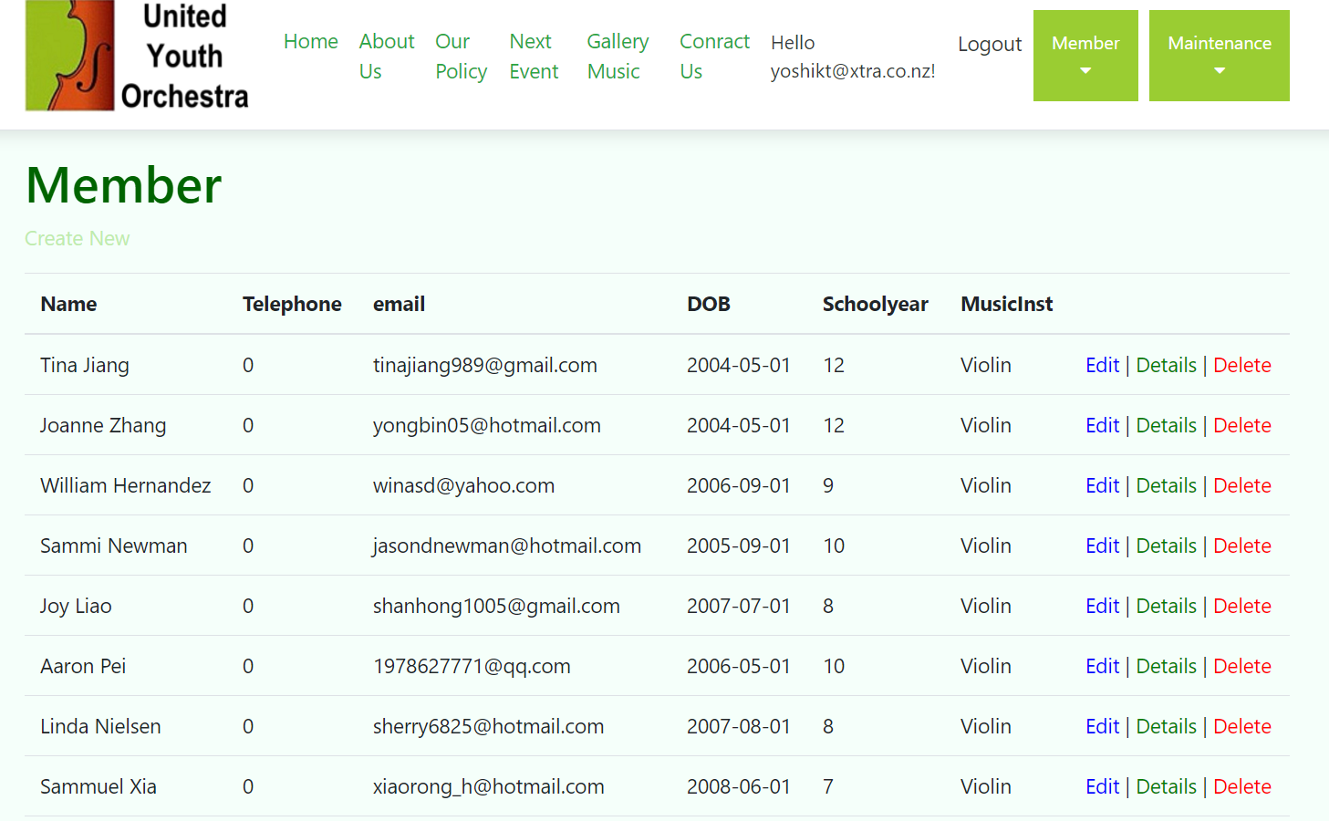
Member
On the Member page, members can get the information of membership listed and can add/edit the information.
Notes:
Member
On the Member page, members can get the information of membership listed and can add/edit the information.

Slide 14
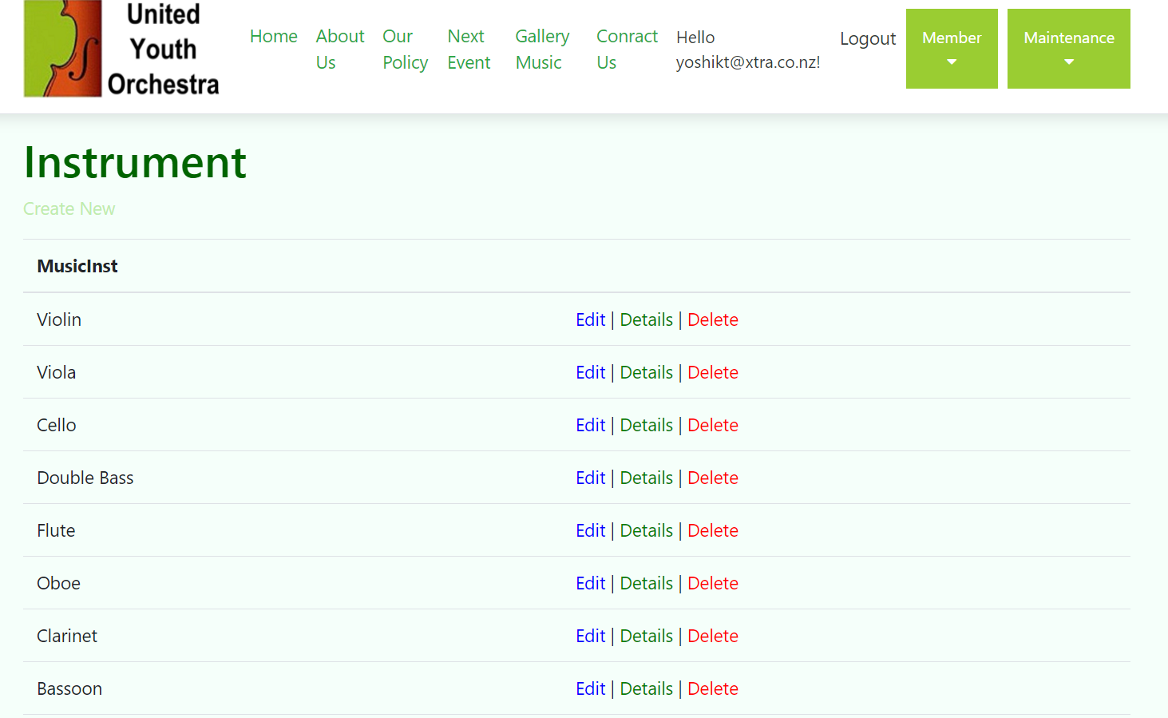
Instrument
On the Instrument page, administrator can add/edit the information.
Notes:
Instrument
On the Instrument page, administrator can add/edit the information.

Slide 15
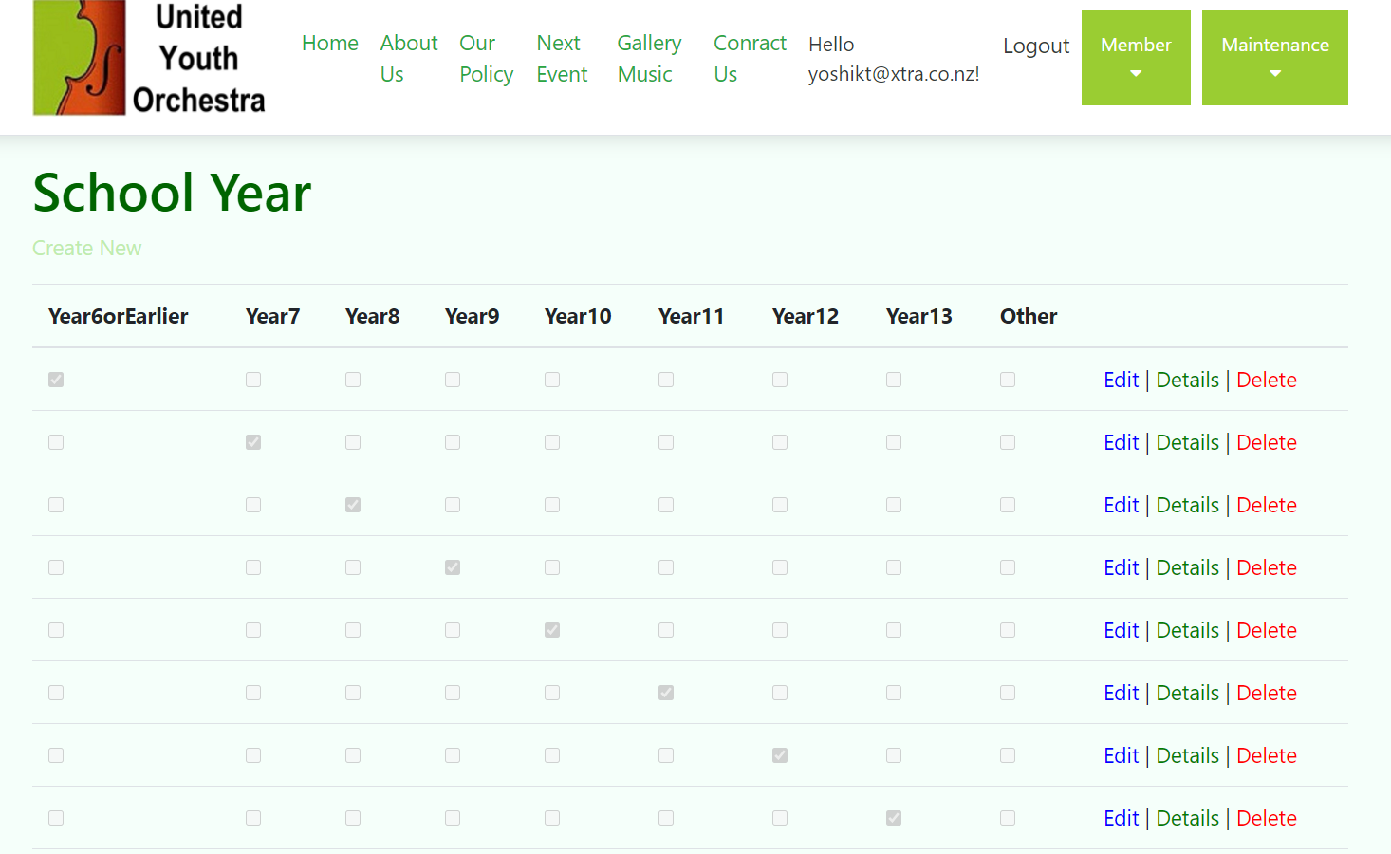
School Year
On the School Year page, administrator can add/edit the information.
Notes:
School Year
On the School Year page, administrator can add/edit the information.

Slide 16
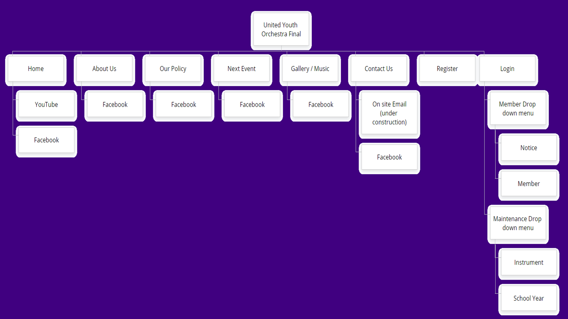
Site map
The relationship pf each page is as above.
Notes:
The relationship pf each page is as above.

Slide 17

Yoshiki Tatsumi

